Slide 1
DevOps
Manoj (Manu)

Slide 2

DevOps overview

Slide 3
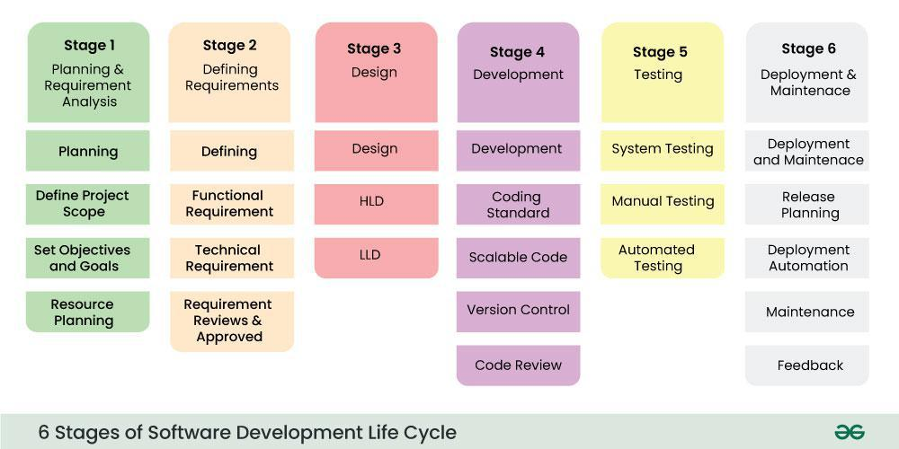
SDLC
Notes:
There are more than 50 SDLC models in the world none of them are perfect, we are going to discuss 2 SDLC models. https://www.geeksforgeeks.org/software-development-life-cycle-sdlc/

Slide 4
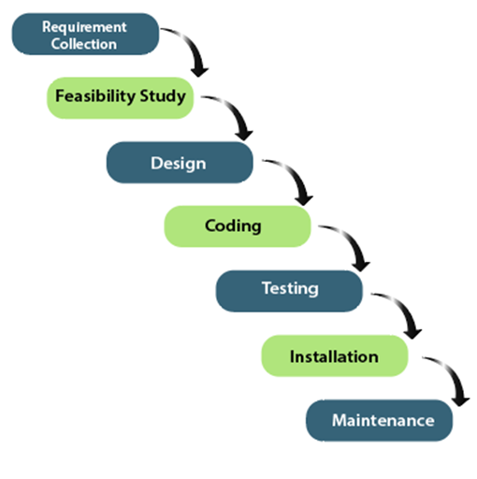
Potential requirements, deadlines and guidelines for the project are analyzed and placed into a functional
specification. This stage handles the defining and planning of the project without mentioning specific processes.
The system specifications are analyzed to generate product models and business logic that will guide production. This is also when financial and technical resources are audited for feasibility.
A design specification document is created to outline technical design requirements such as
programming language, hardware, data sources, architecture and services.
The source code is developed using the models, logic and requirements designated in the prior stages. Typically, the system is designed in smaller components, or units,
before being implemented together.
This is when quality assurance, unit, system and beta tests take place to report issues that may need to be resolved.
The product or application is deemed fully functional and is deployed to a live environment.
First published in
1970 by Dr. Winston W. Royce
Corrective, adaptive and perfective maintenance is carried out
indefinitely to improve, update and enhance the final product. This
could include releasing patch updates or releasing new versions
Waterfall Model

Slide 5
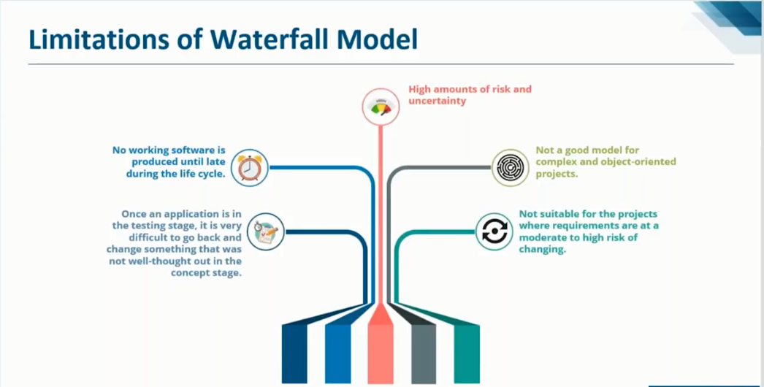

Slide 6
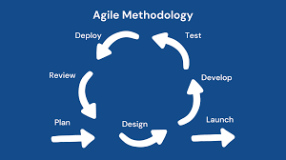
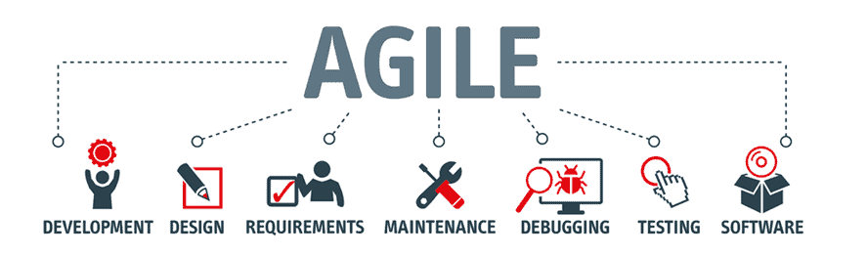
Agile Model comes to rescue
Agile is an iterative approach to project management and software development
that helps teams deliver value to their customers faster and with fewer headaches.
Instead of betting everything on a "big bang" launch, an agile team delivers work in small, but consumable, increments. Requirements, plans, and results are evaluated continuously so teams have a natural mechanism for responding to change quickly.
Notes:
https://www.geeksforgeeks.org/software-engineering-agile-development-models/

Slide 7
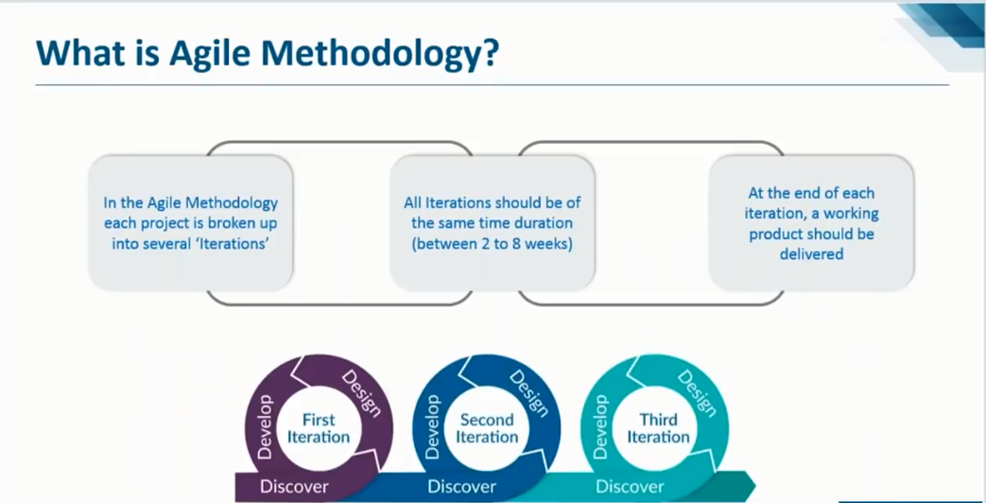

Slide 8
The Difference Between Agile and Scrum
(Systematic Customer Resolution Unraveling Meeting)
On the surface, it is easy to see why Agile and Scrum can often be confused, as they both
rely on an iterative process, frequent client interaction, and collaborative decision making.
Agile Methodology is a development approach where teams work together to adapt and improve solutions based on customer needs and company goals. It focuses on delivering software quickly through repeated cycles of development, allowing for regular feedback and adjustments.
Scrum is a popular agile method that breaks development into cycles called "sprints." Each sprint focuses on a specific task and lasts for a set time. The Scrum team includes a Scrum master and a product owner who communicate daily to stay on track.
Notes:
https://www.geeksforgeeks.org/agile-vs-scrum-difference-between-agile-and-scrum-in-software-development/

Slide 9
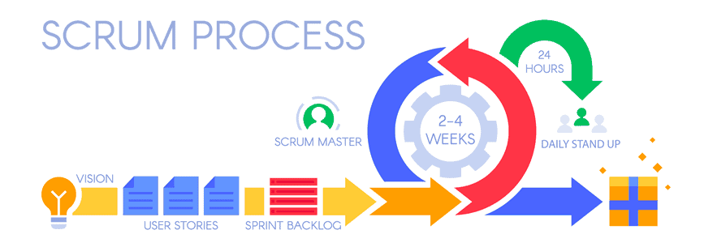

Slide 10
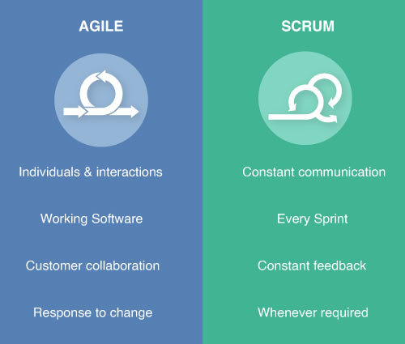
SCRUM Methodology vs Agile model
Notes:
https://www.notifyvisitors.com/pb/blog/agile-vs-scrum/

Slide 11
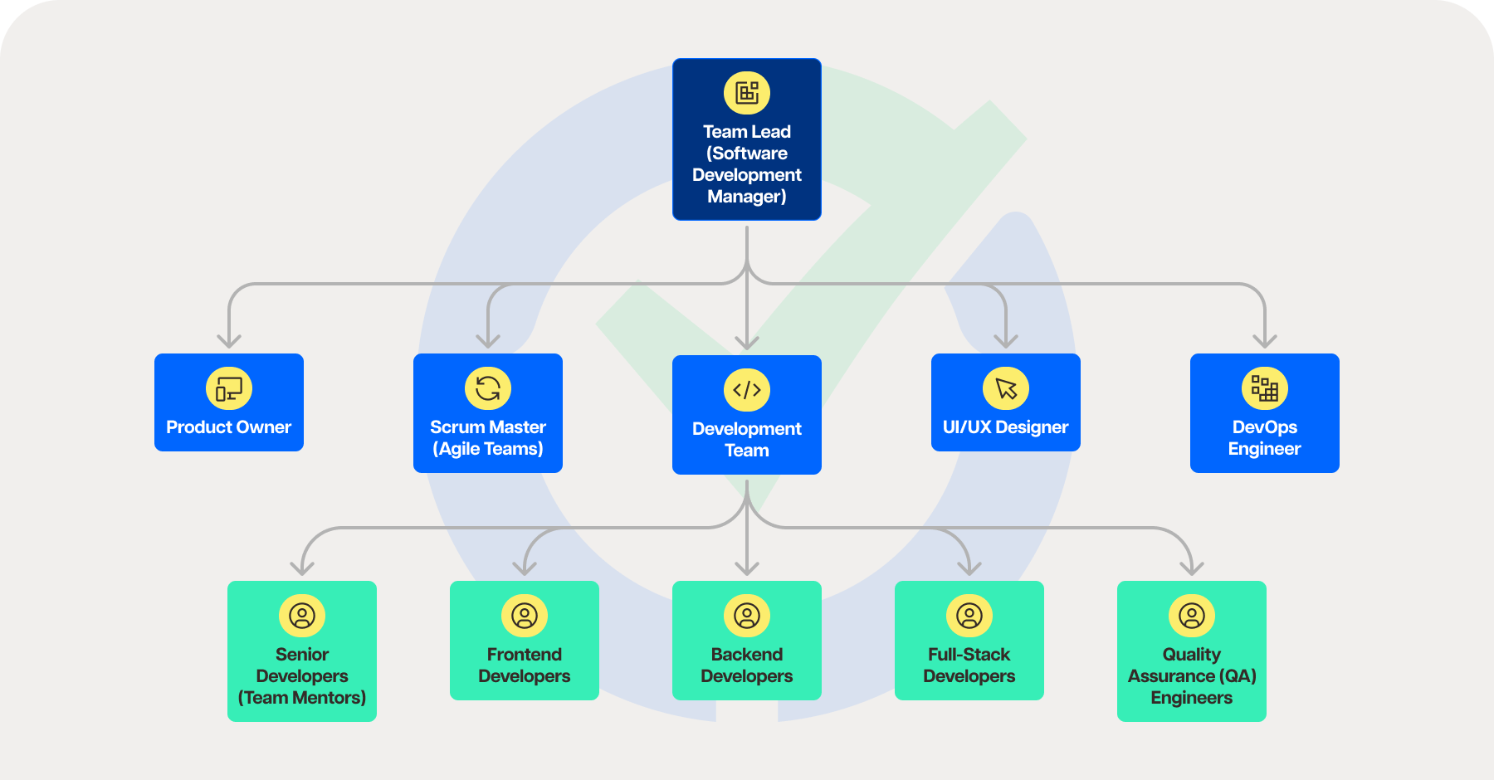
Software Development Team Family
Tree

Slide 12
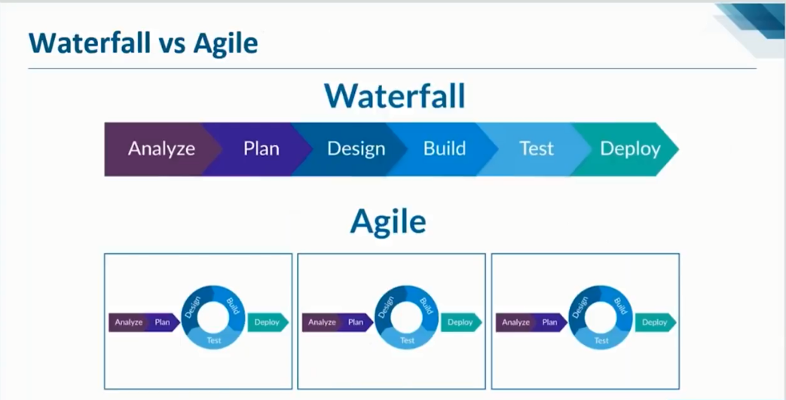

Slide 13
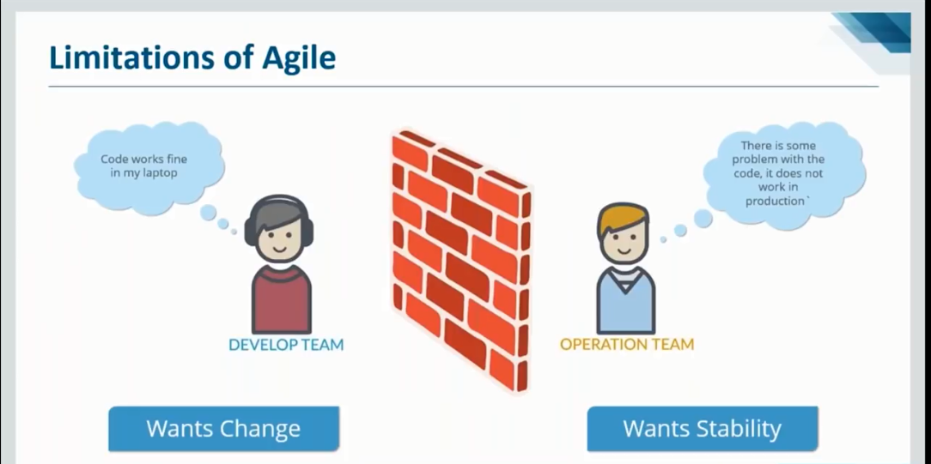

Slide 14
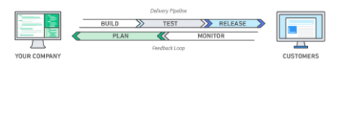
Need For DevOps
Faster Delivery.
Improved Collaboration.
Higher Quality.
Increased Efficiency.
Scalability
Better Customer Experience.`
Notes:
Faster Delivery: DevOps enables faster development, testing, and deployment, leading to quicker releases and updates.
Improved Collaboration: It promotes better communication and collaboration between development and operations teams, breaking down silos.
Higher Quality: Continuous testing and integration in DevOps help identify and fix bugs earlier, improving the quality of the software.
Increased Efficiency: Automation of repetitive tasks reduces manual errors and speeds up the development process.
Scalability: DevOps practices make it easier to scale infrastructure and applications to meet growing demands.
Better Customer Experience: With frequent updates and improvements, DevOps helps deliver a more reliable and feature-rich product to users.

Slide 15
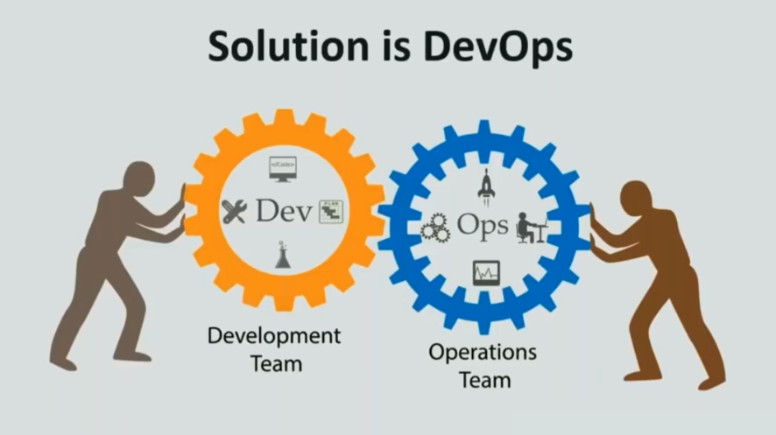

Slide 16
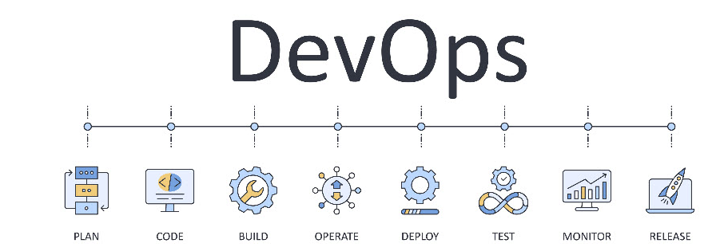
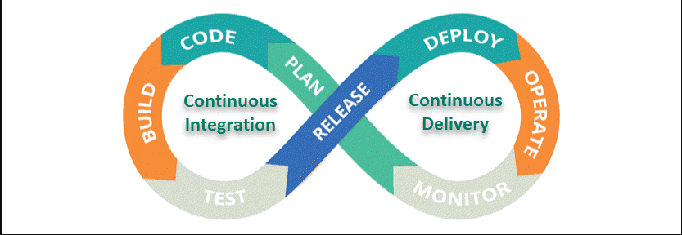
DevOps is a set of practices that encourage software development (Dev) and IT operations (Ops) to work as a single unit
throughout the entire software development lifecycle (SDLC).
DevOps is a set of practices, tools, and a cultural philosophy that automate and integrate the processes between software development and IT teams. It emphasizes team empowerment, cross-team communication and collaboration, and technology automation.
→ Ultimately DevOps is not a Technology it is a Methodology

Slide 17
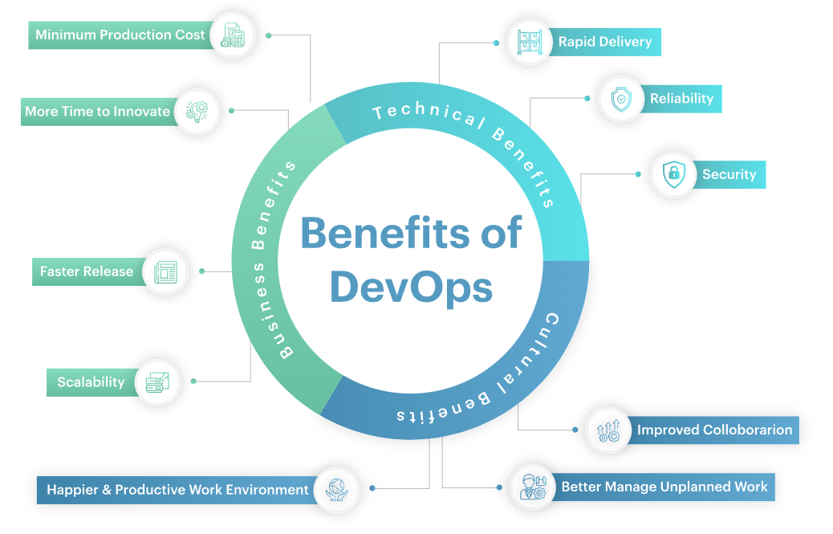

Slide 18
What is DevOps Tools
DevOps is not a technology or a singular framework but a cultural practice to be implemented or rather adopted. To follow
DevOps culture, you often need to use DevOps tools.
DevOps tools is an umbrella terminology that collectively includes platforms, tools, applications, and servers of SDLC in the DevOps model. The main aim of DevOps tools is to streamline, automate and shorten the various phases of the software
delivery pipeline (SDLC).
DevOps toolchain is a collection of tools from different vendors that operate as an integrated unit to build, design, manage, Operate, and measure software systems. DevOps toolchain allows DevOps engineers to collaborate through the
development lifecycle.
The DevOps toolchain cares about all the fundamentals of DevOps, such as automation, continuous integration, continuous delivery, and collaboration.

Slide 19
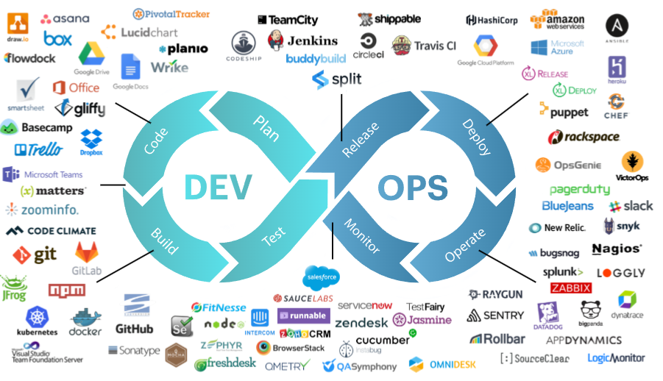

Slide 20
